Slide 1
Debugging and Error Handling
Overview
In this lesson, students will practice identifying and fixing common errors in Python code, along with creating programs that can anticipate specific error types.
Duration 120 minutes
Learning Objectives
In this lesson, students will:
Identify common errors in Python
Read error messages for guidance to fix errors
Implement try/except error handling

Slide 2
Pre-Class Materials and Preparation
For remote classrooms: Virtual breakout rooms and Slack may be needed to facilitate the partner exercise and discussions. As you plan for your lesson:
Consider how you’ll create pairs for the partner exercise (randomly, or with pre-assigned partners).
Determine how (if at all) exercise timing may need to be adjusted.
For helpful tips, keep an eye out for the For remote classrooms tag in the speaker notes.
Prepare screenshots and answers to exercises in advance so that they can be easily shared in Slack during your lecture.

Slide 3
Suggested Agenda
Time | Activity
0:00–0:30 | Welcome + Debugging and Error Handling
0:30–1:00 | Error Scavenger Hunt
1:15–1:45 | Debugging a Sort Function
1:50–2:00 | Wrapping Up, Q&A, and Exit Ticket Completion

Slide 4
Jupyter Notebook
The exercises referenced in this lesson can be found in the Python Workbooks + Data folder.

Slide 5
Debugging and Error Handling
Notes:
Duration: 30 minutes

Slide 6
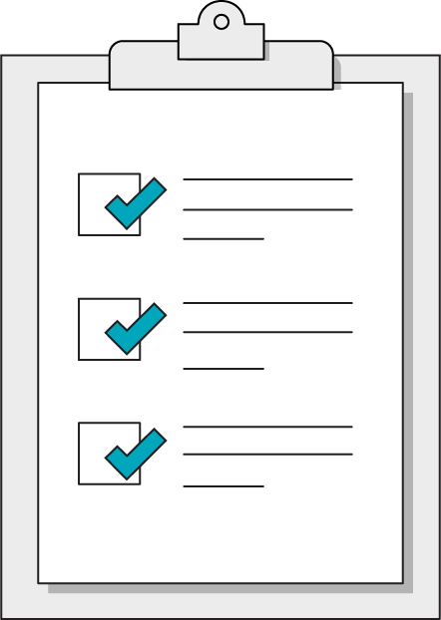
Our Learning Goals
Identify common errors in Python
Read error messages for guidance to fix errors
Implement try/except error handling
Notes:
Purpose: Set expectations for the lesson.
TEACHING TIPS:
Today's topics may seem a bit basic, but remind students that these are the foundational building blocks of complex programs. No matter how far they get as programmers, data types will ALWAYS matter and can often be the source of bugs!
For remote classrooms:
Capture a screenshot of this slide and drop it in the class Slack channel.

Slide 7
Making Errors Into Friends
Python errors are very helpful and typically have clear messages.
Errors sometimes say exactly what's wrong.
Some errors have very common causes.
Errors may say exactly how to fix the issue.
Once you've seen the same error a few times, you'll start to know exactly where to look to fix the problem.
Notes:
Purpose: Explain why error messages are actually our friends.
TALKING POINTS
On the surface, errors are frustrating! However, they generally tell you what’s wrong so you can fix it!
You will have a much better time programming if you learn to use error messages as a guide instead of a blocker.

Slide 8
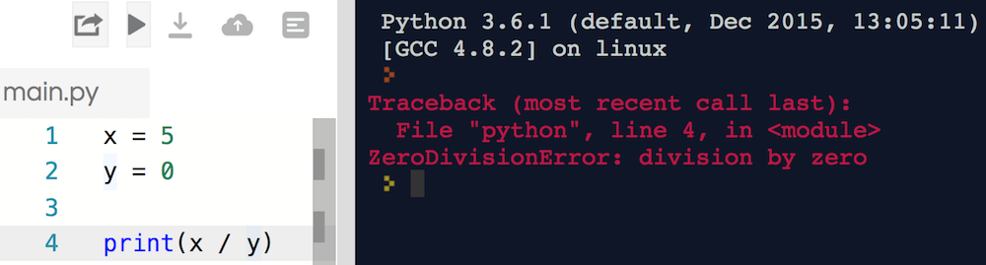
Error Messages
What's wrong with the code snippet below? What information is the error message giving us?
Notes:
Purpose: Give students a chance to interpret a real error message.
TALKING POINTS
Let’s dissect this error message.
The error gives us the File and Line Number that caused the error, along with what type of error (ZeroDvisionError) and a brief description.

Slide 9
Error Scavenger Hunt
30 minutes
We've curated a selection of the most common errors available in Python.
Run each of the code blocks in the notebook, read the error message, then describe in your own words what the error type means.
Notes:
Purpose: Give students an opportunity to play around with real errors.
TEACHING TIPS
Once students have completed this exercise, review and discuss each of the error types. You might also demonstrate the results when googling the error message to talk students through the process of finding good answers.
For remote classrooms

Slide 10
Logic Errors
Program Errors are easy to spot: your code won't run, and it will complain about why.
Logic Errors are tougher to track down. The code snippet on the right, while running error-free, is not doing what the programmer expected.
def multiply(num_1, num_2):
return num_1 + num_2
hundred = multiply(10, 10)
# hundred is actually 20!
Notes:
Talking points: Your code can run error-free but still not do what you want it to.

Slide 11
Print Your Way to Freedom!
When debugging logic errors, print statements at each step of the way can reveal where the program went wrong. You might add print statements to:
Determine which blocks of code execute, and in what order
Reveal the value of specific variables and parameters used
Test out individual blocks of code to ensure they work as expected
Notes:
Purpose: Explain the importance of using print.
TALKING POINTS

Slide 12
Debugging a Sort Function
30 minutes
We're trying to write a common sort function, bubble sort. However, our code has run into some errors, both logical and programmatic.
Use print statements and error codes to determine where the code is going wrong, taking things one step at a time.
Notes:
Talking Points: You might want to describe the thought process behind bubble sort so students can more clearly understand what the intention of the code is.

Slide 13
Programmatic Error Handling
Debugging and Error Handling
Notes:
Duration: 15 minutes

Slide 14
User Input: Causing Errors Since Forever
Common offenders:
Applications that require user input will, inevitably, get input from the user that isn't valid or doesn't make sense for the program.
Applications that make requests to external data sources can sometimes get bad results, or no results, in response to their requests.
We need a way of creating programs that can anticipate when a block of code might run into an error.
Notes:
Purpose: Introduce the common challenges of user input.
TALKING POINTS
Ideally, we can keep modifying our programs until they're free of errors. However, for some programs, errors are inevitable.
Applications that require user input and those that make requests to external data sources are repeat offenders.\

Slide 15
Try and Except Your Code
Fortunately, errors don't have to be the end of the world! Once you start to anticipate what could go wrong, you can use try and except statements to plan ahead.
try:
starting_value = int(input("Give me a number one through ten"))
except ValueError:
print("Your input was not a number. Try again.")
Notes:
Purpose: Introduce Try and Except statements.
TALKING POINTS
Try-Except statements is one way we can catch errors in Python
It is important to note the indentation, which defines which code block might throw the error, and what code should execute in the case of the expected error.
Sometimes you may expect certain code to throw an error, and you may want to handle that situation with a smooth error message as opposed to having your whole program blow up.

Slide 16
Try-Except Options
. We can catch:
One error
except ValueError:
Multiple errors
except (ValueError, KeyError):
Any/every error
except err:
Try to specify the error, if possible! You can even string several except statements to handle different errors differently.
Notes:
Purpose: Show an example of try-except.
TALKING POINTS
Always try to specify the error, if possible! You can even string several except statements to handle different errors differently.

Slide 17
Accessing an Error
You can use the as statement, or aliasing, to turn your exception into a specific, accessible object:
try:
risky_function()
except ValueError as value_err:
print("Value error: ", value_err)
except Exception as err:
print(err)
Notes:
Purpose: Show an example of try-except.
TALKING POINTS
In this example, we have a catch-all except at the end, just in case there's a totally unanticipated type of error.

Slide 18
Creating Your Own Errors (On Purpose This Time)
lucky_number = int(input("Type a number that's less than 100"))
if(lucky_number > 100):
raise ValueError("The number needs to be less than 100!")
Why would we do this?
Notes:
Purpose: Introduce the concept of creating errors on purpose.
TALKING POINTS
We can also have our programs throw errors whenever we'd like.
Why? typically if a user's input doesn't match our expectations.
Raising our own error will behave the same as a built-in error: unless we're handling it with a try-except block, it'll shut down the program.

Slide 19
Error Handling Possibilities
5 minutes
Proper error handling is all about thinking through every possibility. You should have a plan for every logical situation. What's the plan below? Add comments to the code block to explain what each line is doing.
try:
lucky_number = int(input("Type a number that's less than 100"))
if(lucky_number > 100):
raise ValueError("The number needs to be less than 100!")
process_valid_number(lucky_number)
except ValueError as err:
print("You need to provide a number")
Notes:
Purpose: Give students an opportunity to discuss the error handling example.
TALKING POINTS
We want a number that's less than 100, so there's three possibilities: We're not given a number, we're given a number that's not less than 100, or we're given a number that's less than 100.
For remote classrooms: Have students come off of mute to share their plan.

Slide 20
Wrapping Up
Debugging and Error Handling
Notes:
Duration: 10 minutes

Slide 21
Recap
Looking Ahead
In today’s class, we…
Identify common errors in Python
Read error messages for guidance to fix errors
Implement try/except error handling
Next Class:
Python Fundamentals Review Lab
Notes:
Purpose: Recap what was covered in the lesson.

Slide 22

Don’t Forget: Exit Tickets!

